Slide 1
Probability Distribution

Slide 2
Scenarios
Consider there is a bag containing 100 balls: 30 red, 20 blue and 50 black balls.
Changes of drawing two blue balls or two red ball from the drawer
Changes of pulling out three balls or have matching pair.
Changes of drawing five balls and they are all black.
A random sample of 10 balls from the bag produced one blue, four red, five black balls. What is the total population of black, blue or red balls in the bag?
We randomly sample 10 balls, and write down the number of black balls and then return the balls to the drawer. The process is done for five times. The mean number of balls for each of these trial is 7. What is the true number of black balls in the bags?
Probability
Statistics

Slide 3
Probability and Statistics
In probability, we are given a model and asked what kind of data we are likely to see.
In statistics, we are given data and asked what kind of model is likely to have generated it.

Slide 4
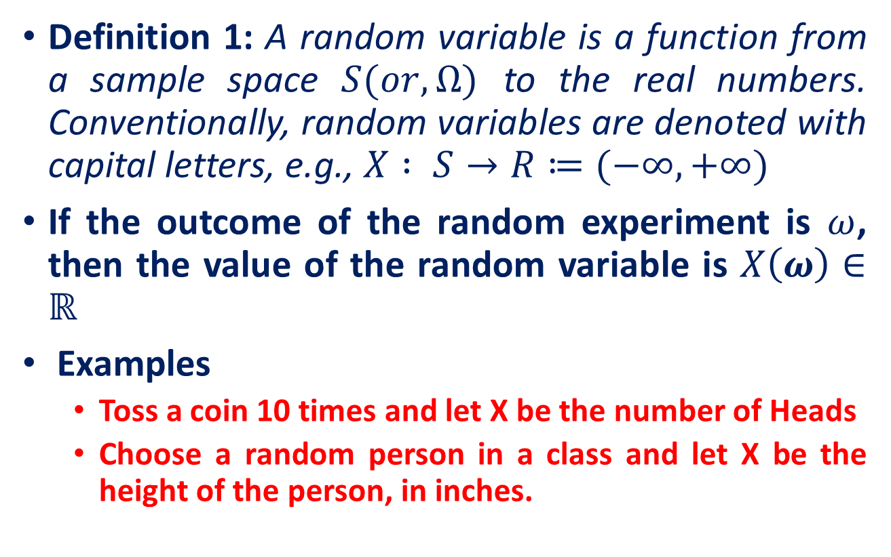
Random Variable

Slide 5
Random Variable
Discrete Random Variable
Continuous Random Variable

Slide 6
Discrete Random Variable
Random variables that can assume a countable number (finite or infinite) of values are called discrete.
Examples
Experiment
Random Variable
Possible Values
Make 100 Sales Calls
# Sales
0, 1, 2, ..., 100
Inspect 70 Radios
# Defective
0, 1, 2, ..., 70
Answer 33 Questions
# Correct
0, 1, 2, ..., 33

Slide 7
Continuous Random Variable
A continuous random variable is a random variable with infinitely many possible values (in an interval of real numbers ).
Experiment
Random Variable
Possible Values
Weigh 100 People
Weight
45.1, 78, ...
Measure time taken
Hours
900, 875.9, ...
Amount spent on food
$ amount
54.12, 42, ...
Measure Time
Inter-Arrival
0, 1.3, 2.78, ...
Between Arrivals
Time

Slide 8
Probability Distributions
Definition: Probability Distribution
A probability distribution of a random variable X is a description of the probabilities associated with the possible values of X
Example
Let X = # of heads observed when a coin is flipped twice
Number of Heads | 0 | 1 | 2
Probability | 1/4 | 2/4 | 1/4

Slide 9
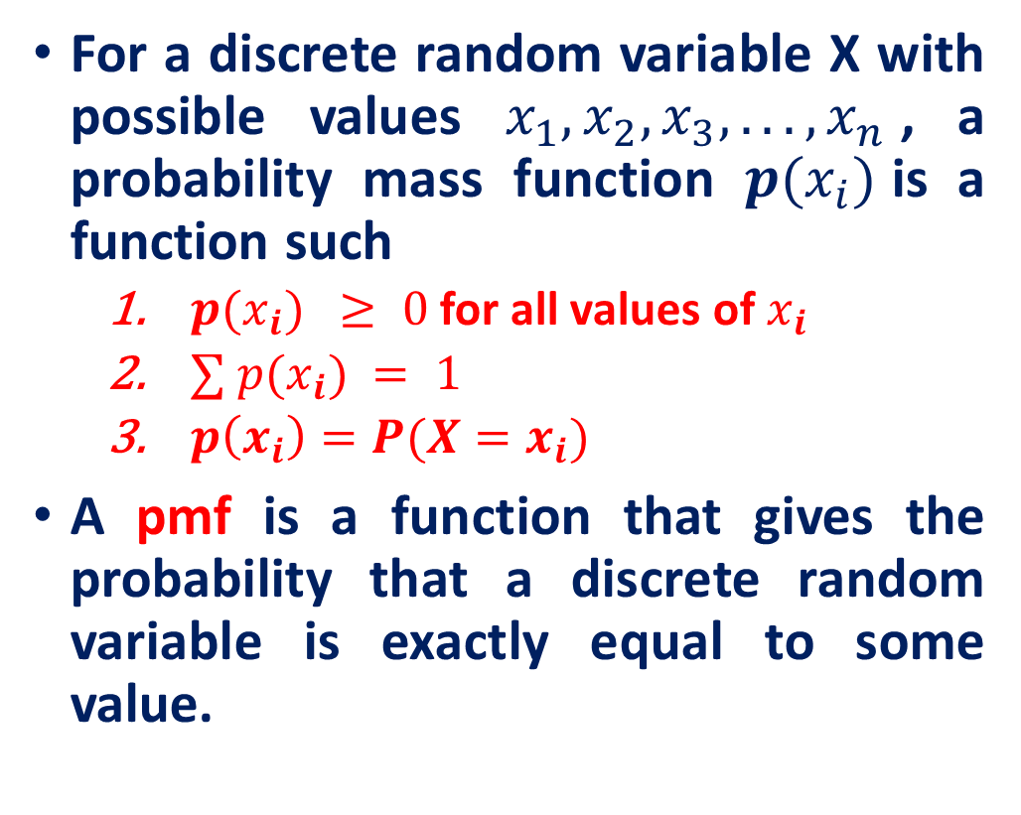
Probability Mass Function (PMF)
Example (Probability Mass Function (PMF)): Tossing a die
x
p(x)
1
p(x=1)=1/6
2
p(x=2)=1/6
3
p(x=3)=1/6
4
p(x=4)=1/6
5
p(x=5)=1/6
6
p(x=6)=1/6
1.0

Slide 10
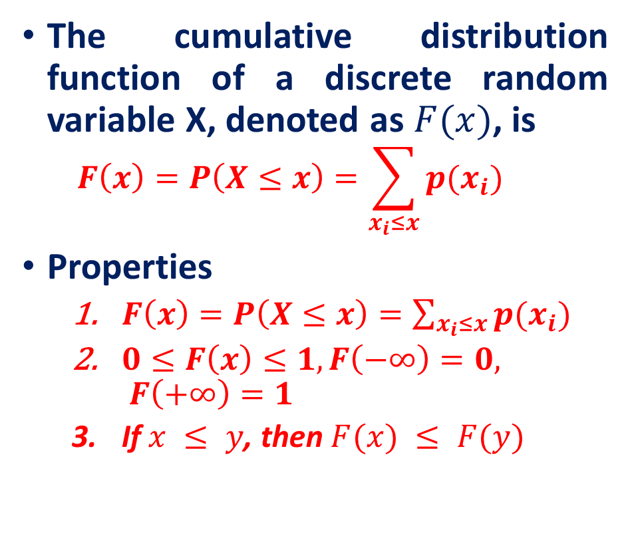
Cumulative Distribution Function (CDF)
Example (CDF): Tossing a die
1
2
3
4
5
6

Slide 11
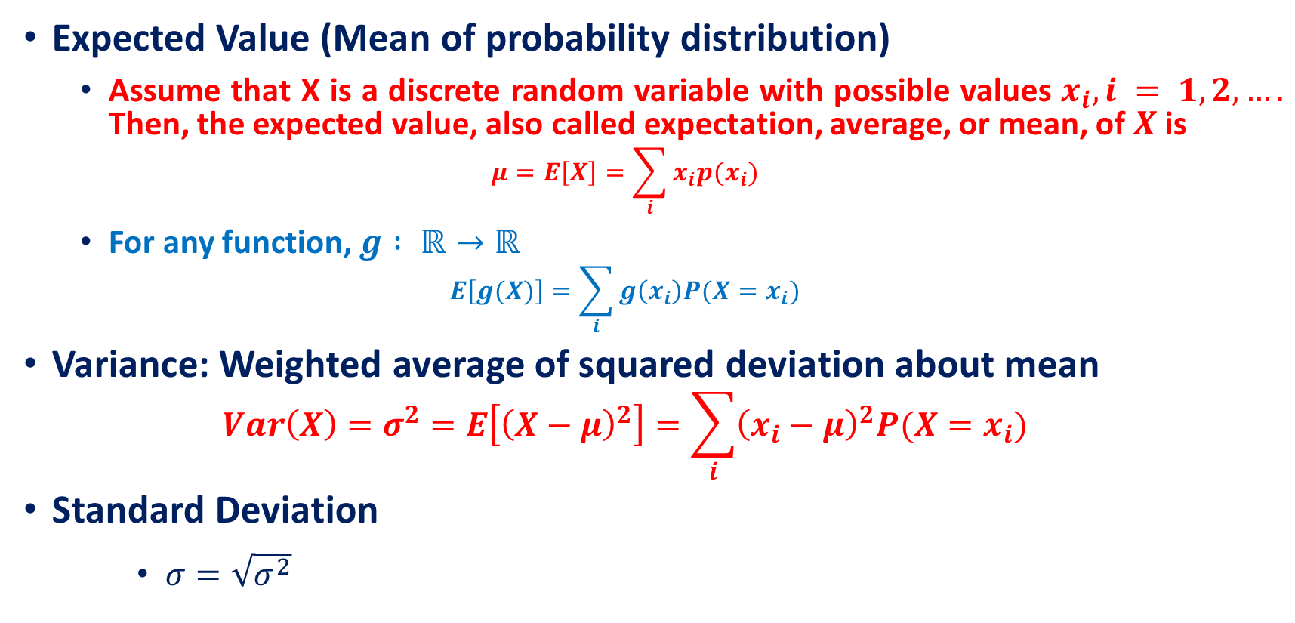
Summary Measures

Slide 12
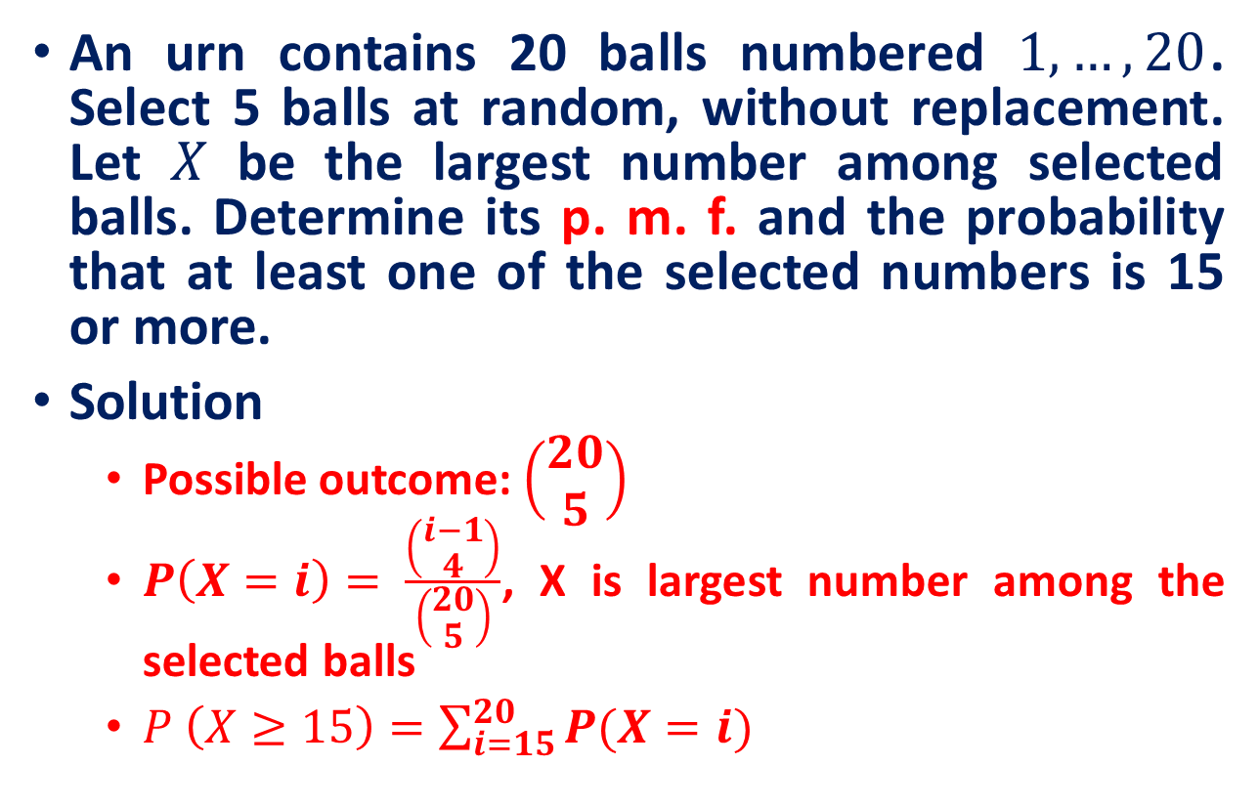
Example

Slide 13
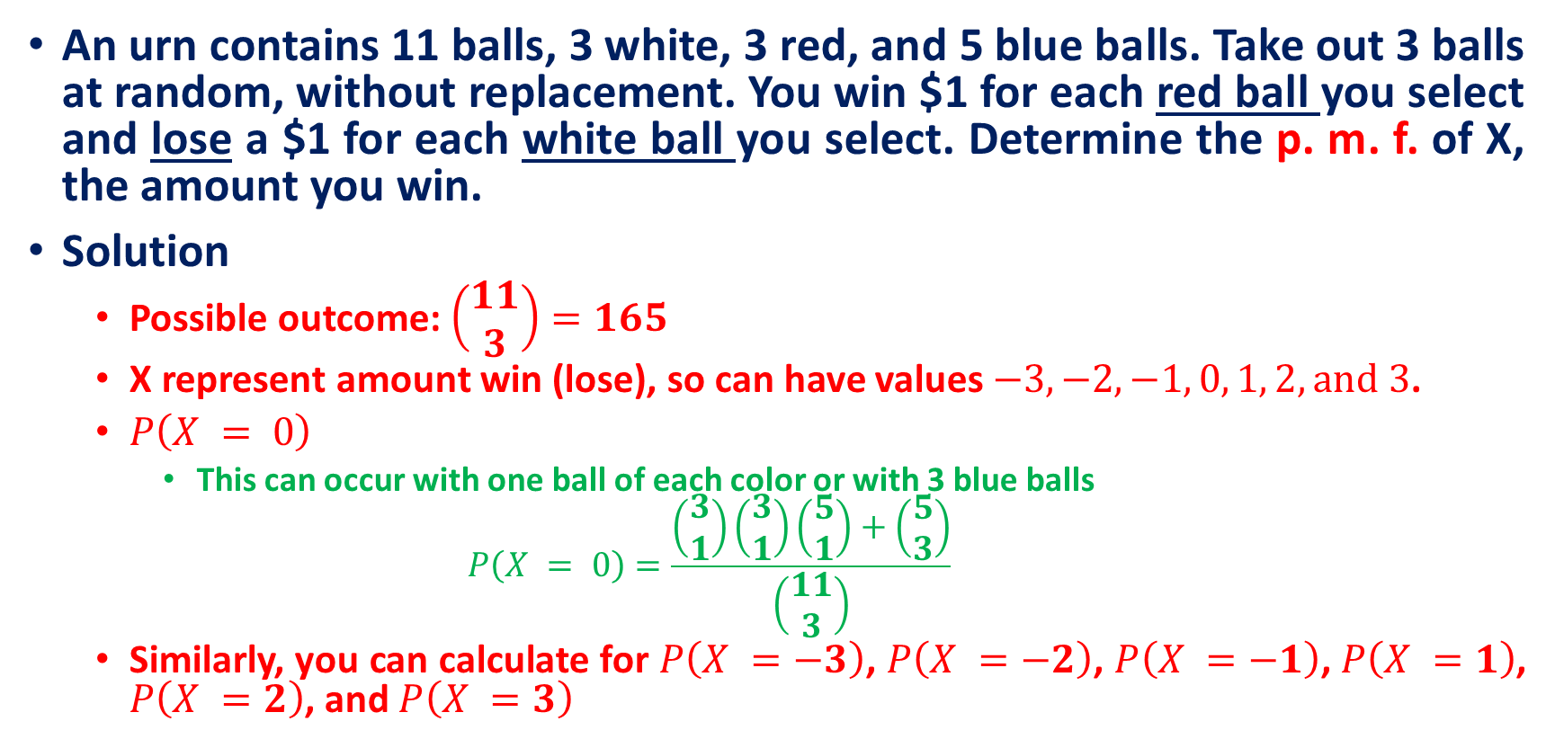
Example

Slide 14
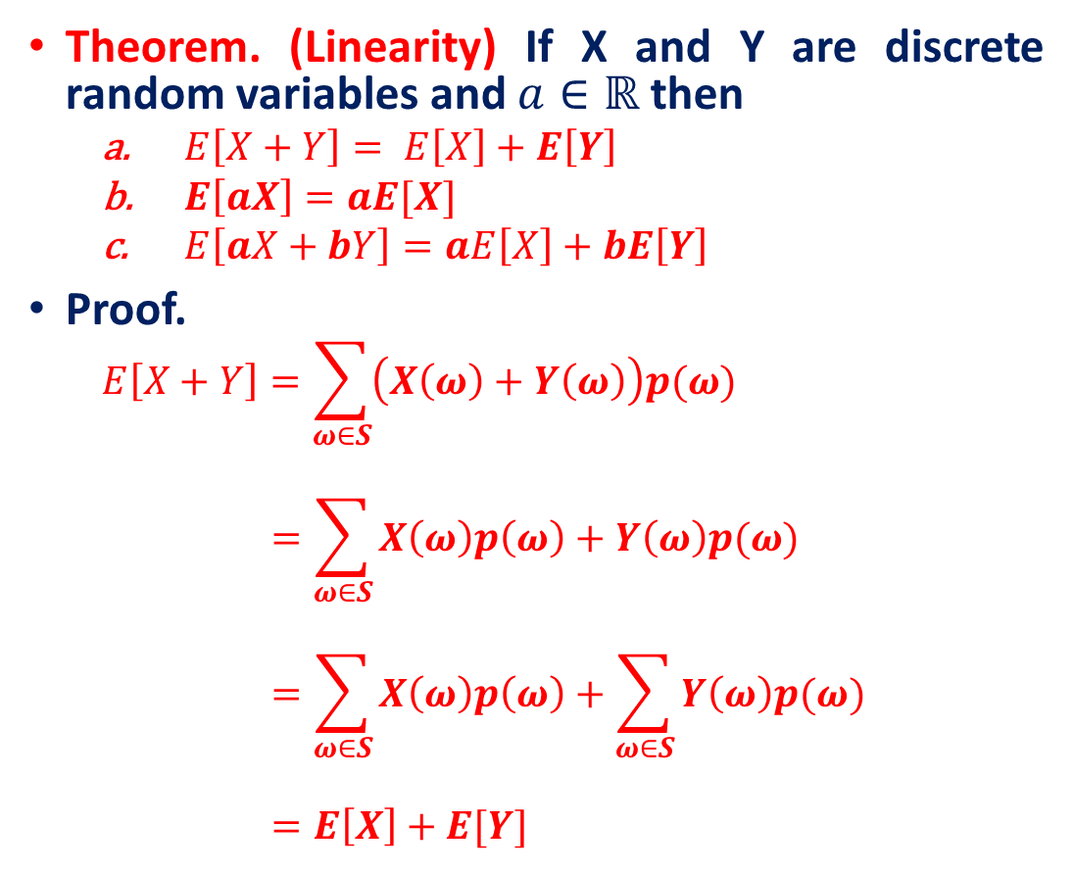
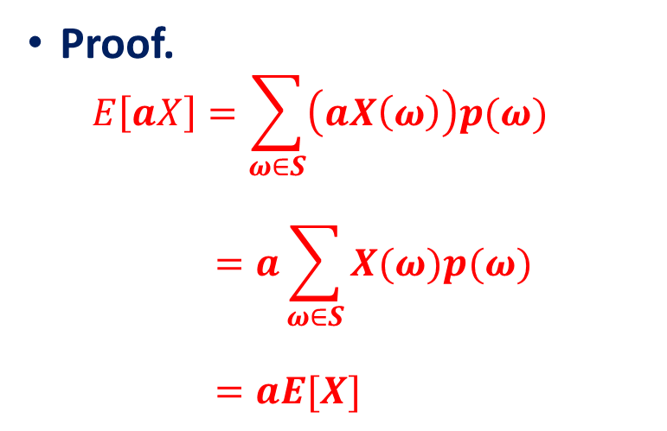
Expected Value

Slide 15
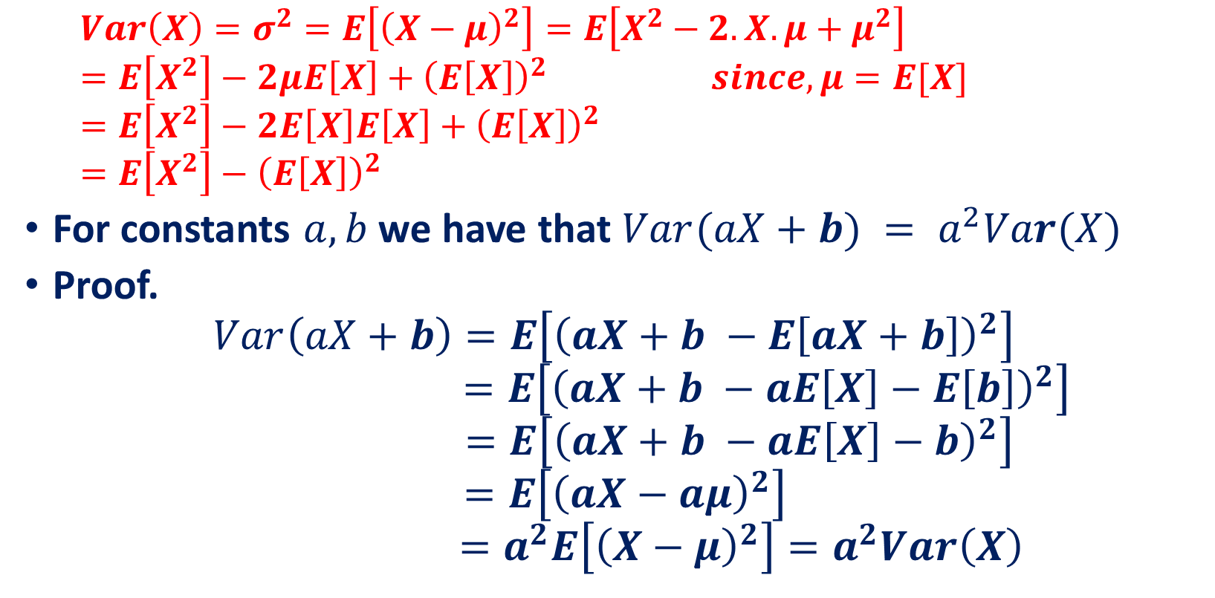
Variance

Slide 16
Taxonomy of Probability Distributions
Discrete Random Variable
Discrete probability distributions
Binomial distribution
Multinomial distribution
Poisson distribution
Hypergeometric distribution
Continuous probability distributions
Normal distribution
Standard normal distribution
Gamma distribution
Exponential distribution
Chi square distribution
Lognormal distribution
Weibull distribution
Continuous Random Variable

Slide 17
Discrete random variables

Slide 18
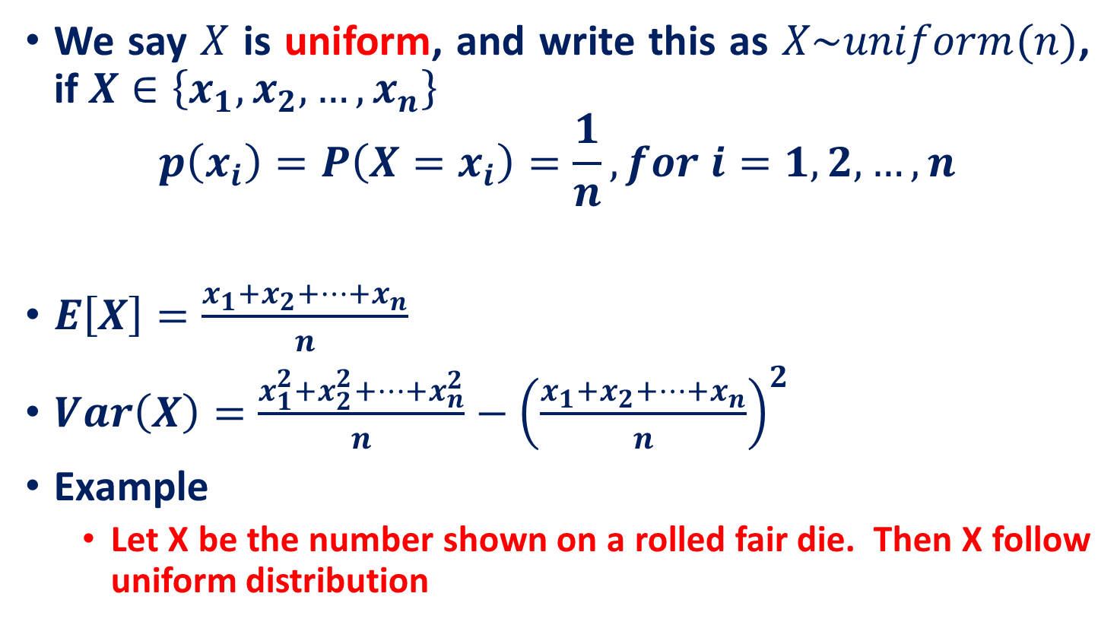
Uniform discrete random variable

Slide 19
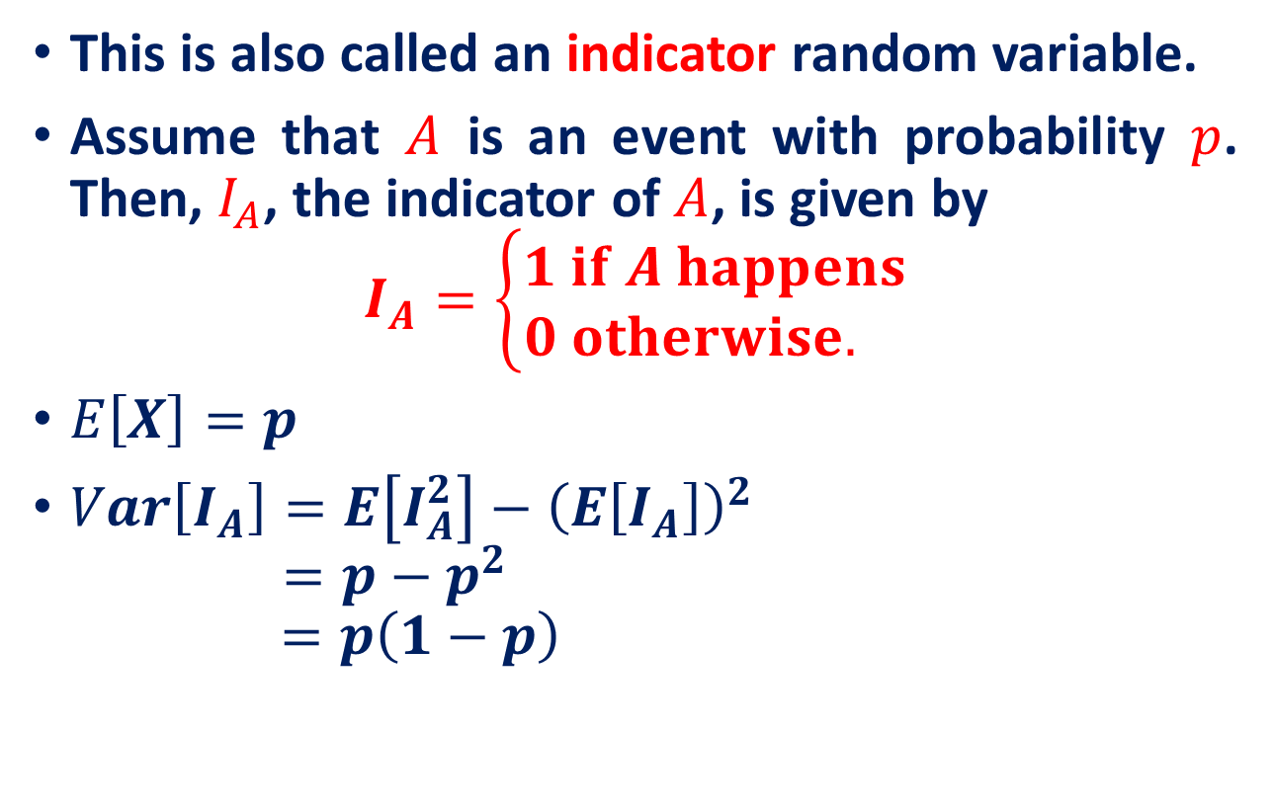
Bernoulli random variable

Slide 20
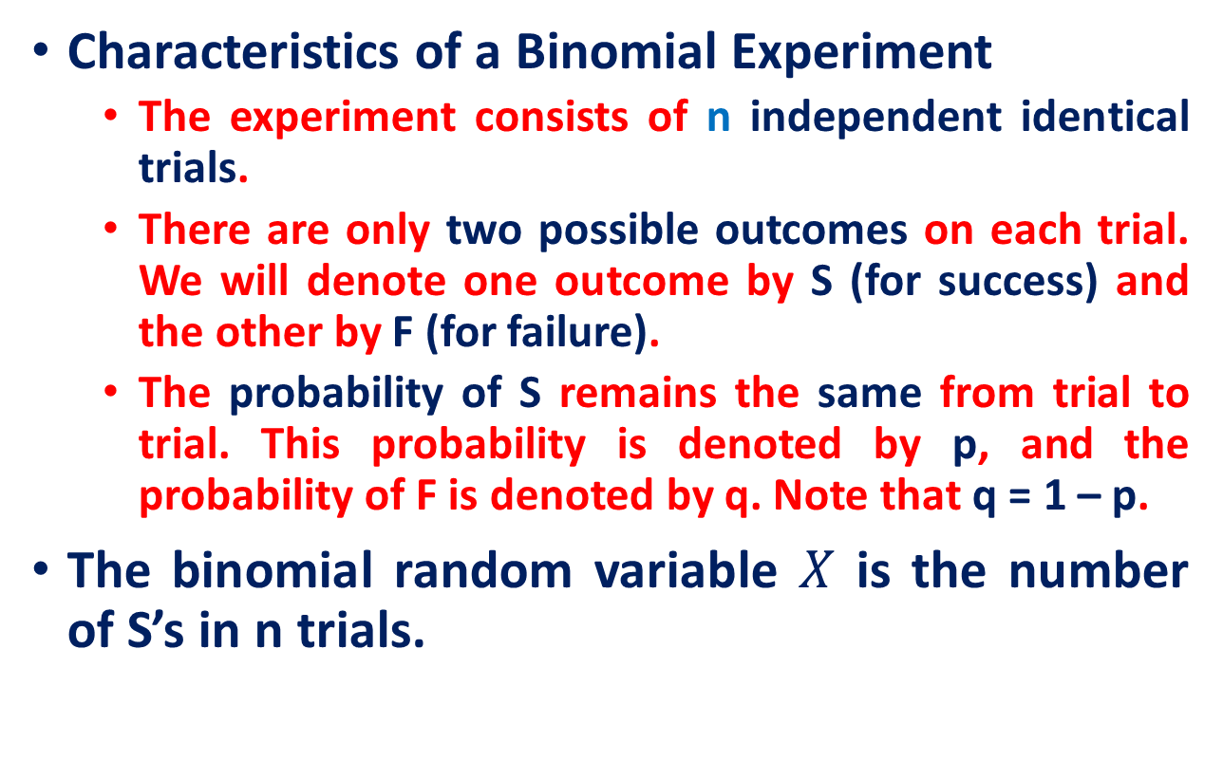

Binomial random variable

Slide 21
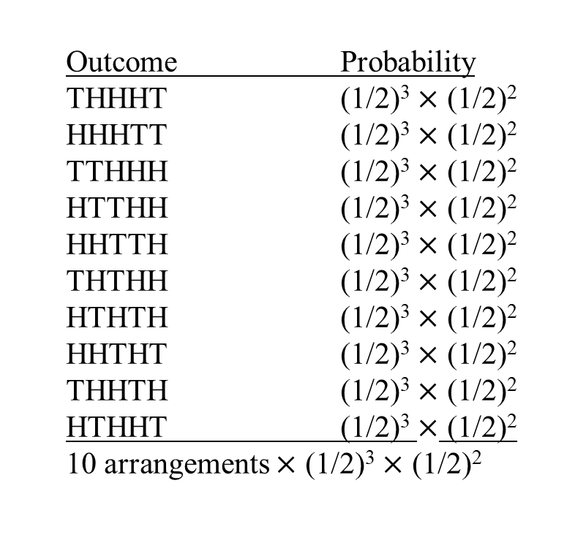
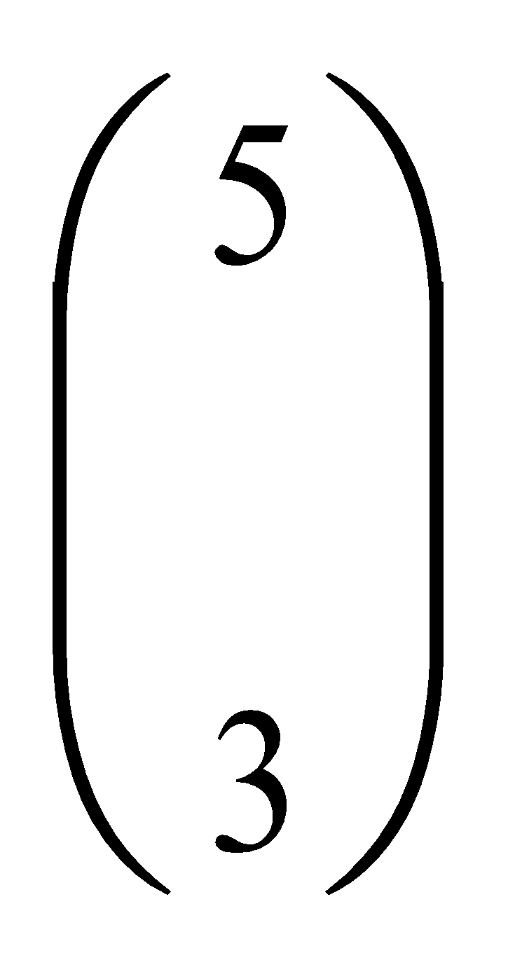
Binomial example
Take the example of 5 coin tosses. What’s the probability that you flip exactly 3 heads in 5 coin tosses?
ways to arrange 3 heads in 5 trials
The probability of each unique outcome (note: they are all equal)
5!/3!2! = 10

Slide 22
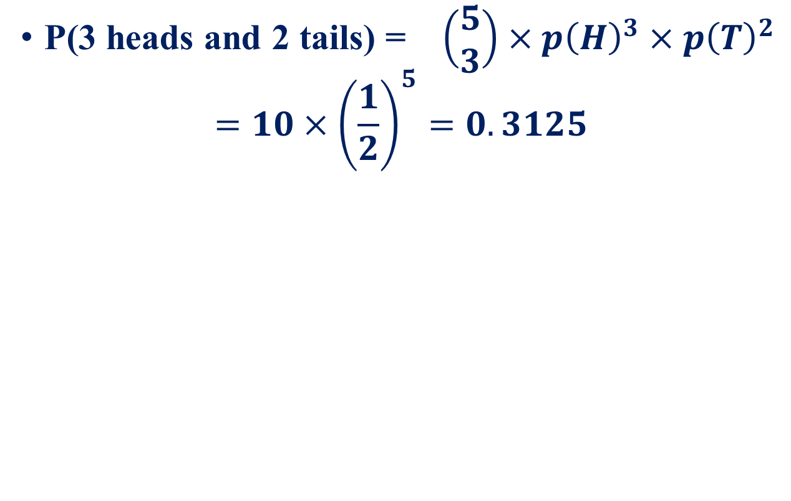
Binomial example

Slide 23
Binomial example
You’re a telemarketer selling service contracts for Jio. You’ve sold 20 in your last 100 calls (p = .20). If you call 12 people tonight, what’s the probability of
No sales?
Exactly 2 sales?
At most 2 sales?
At least 2 sales?

Slide 24
Binomial example
n = 12, p = .20
p(0) = .0687
p(2) = .2835
p(at most 2) = p(0) + p(1) + p(2) = .0687 + .2062 + .2835 = .5584
p(at least 2) = p(2) + p(3)...+ p(12) = 1 – [p(0) + p(1)] = 1 – .0687 – .2062 = .7251

Slide 25
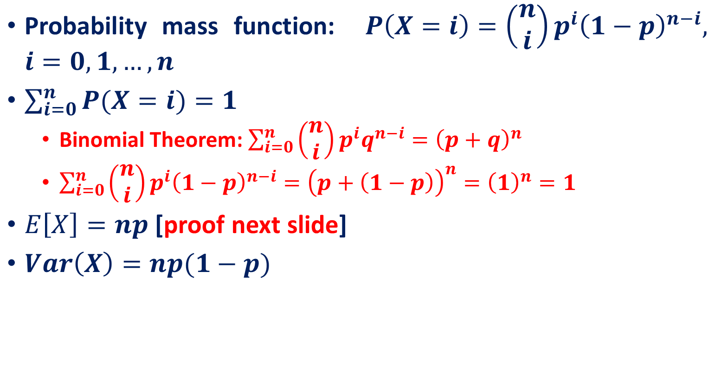
Properties

Slide 26
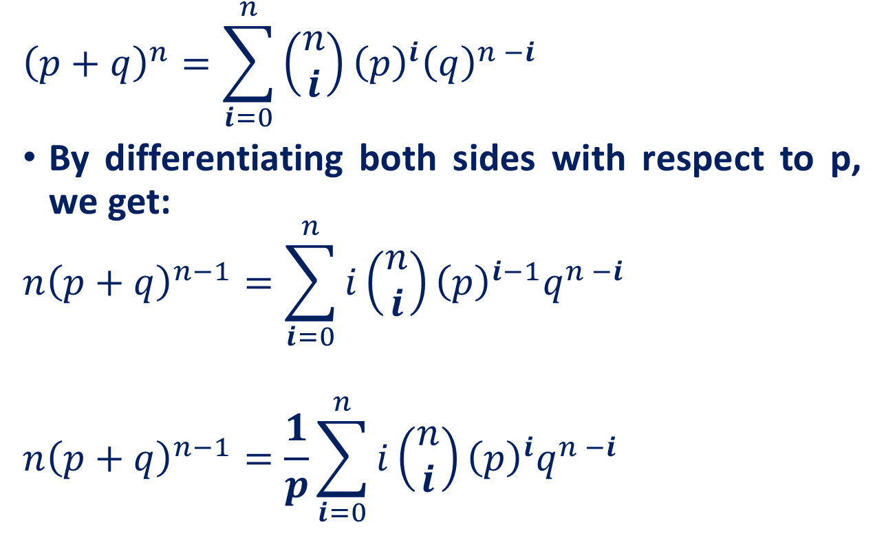
Binomial random variable
Binomial Theorem

Slide 27
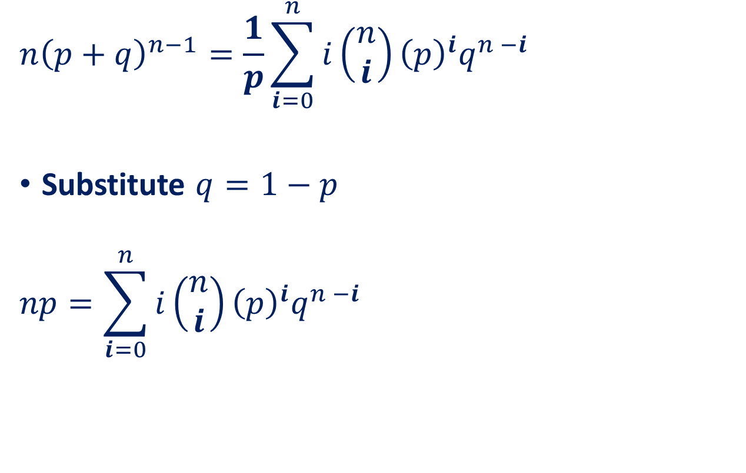
Binomial random variable

Slide 28
Poisson Distribution
Number of events that occur in an interval
events per unit
Time, Length, Area, Space
Examples
Number of customers arriving in 20 minutes
Number of strikes per year in the India.
Number of defects per lot (group) of DVD’s

Slide 29
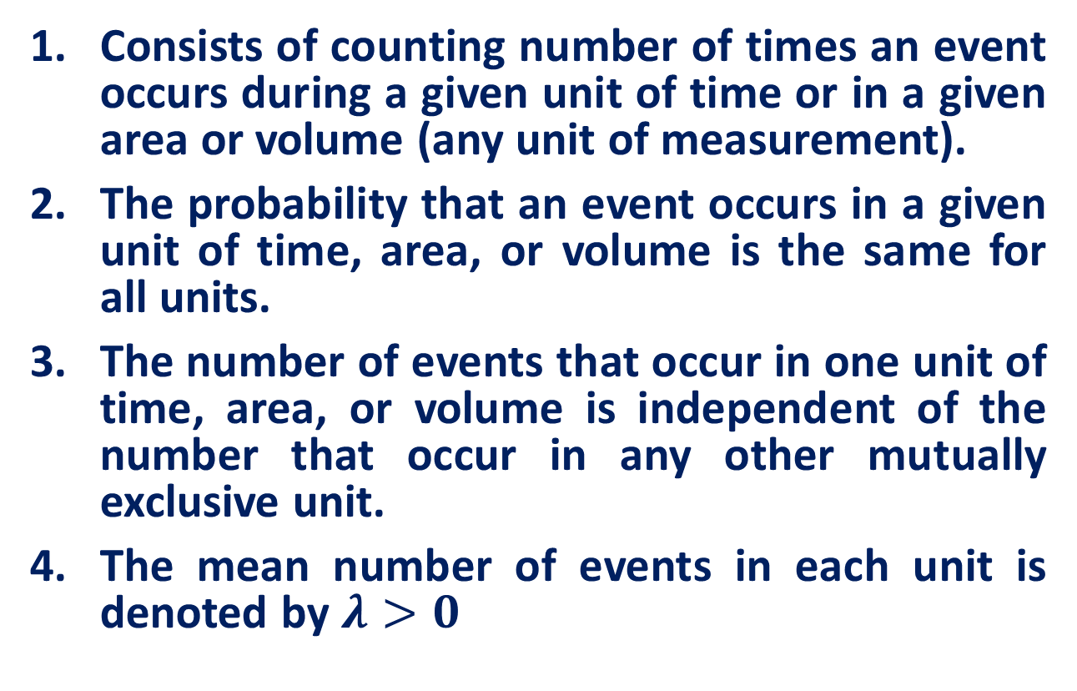
Poisson Distribution

Slide 30
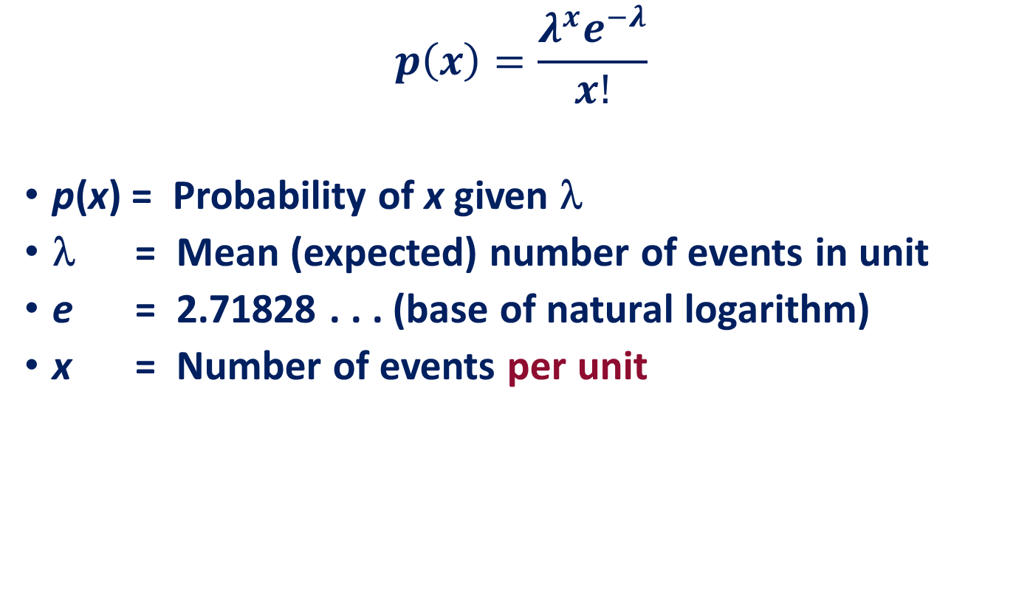
Poisson Probability Distribution Function

Slide 31
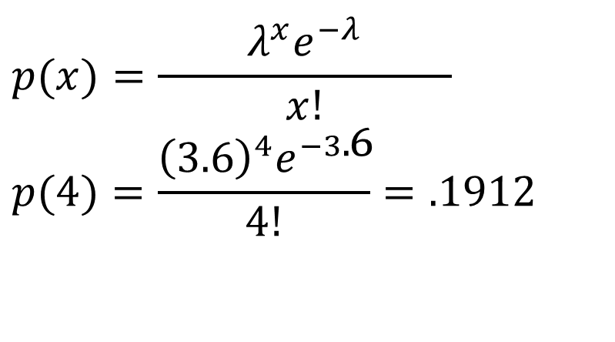
Poisson Distribution
Customers arrive at a rate of 72 per hour. What is the probability of 4 customers arriving in 3 minutes?
Solution
72 Per Hr. = 1.2 Per Min. = 3.6 Per 3 Min. Interval

Slide 32
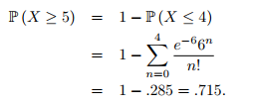
Poisson Distribution
Bob receives texts on the average of two every 3 minutes. Assume Poisson.
Question: What is the probability of five or more texts arriving in a 9−minute period

Slide 33
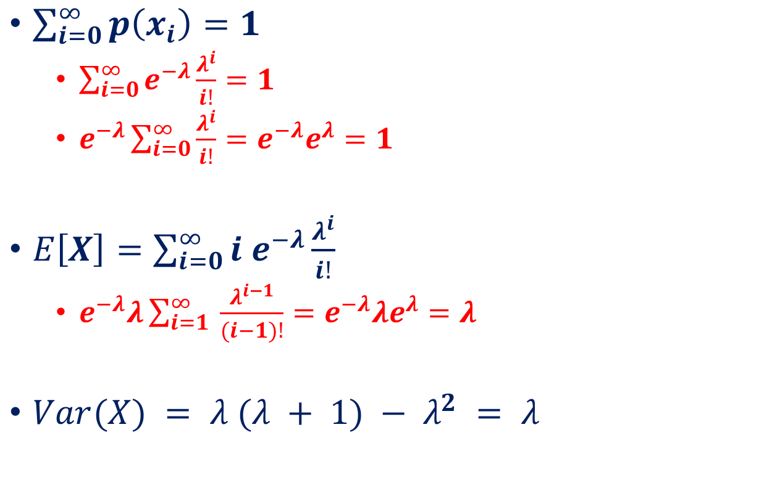
Properties of Poisson Distribution

Slide 34
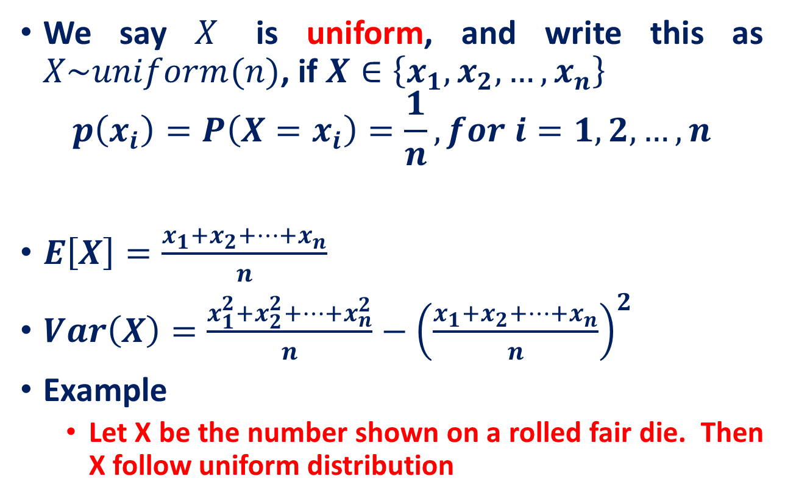
Recall: Uniform discrete random variable

Slide 35
Recall: Binomial random variable

Slide 36
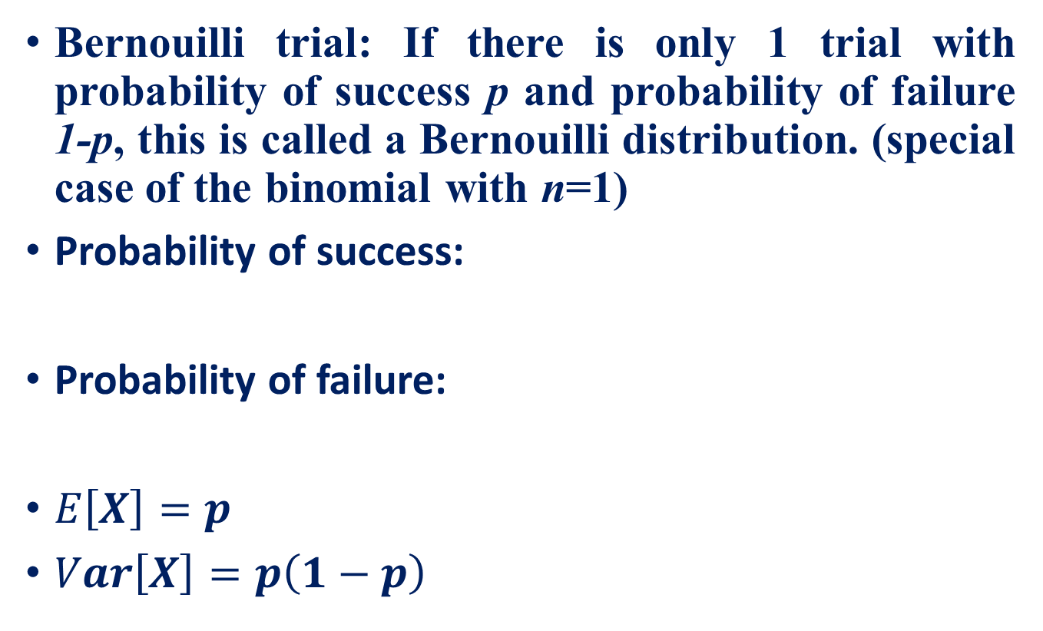
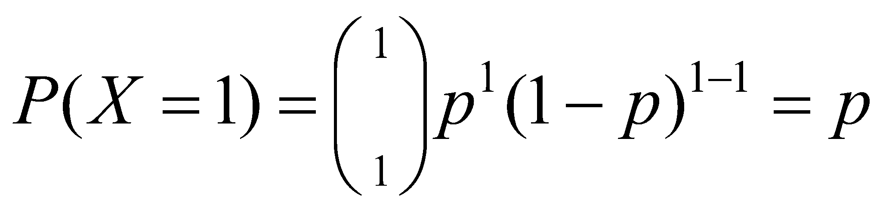
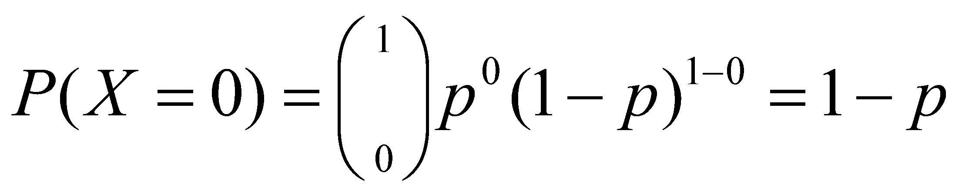
Recall: Bernoulli random variable

Slide 37
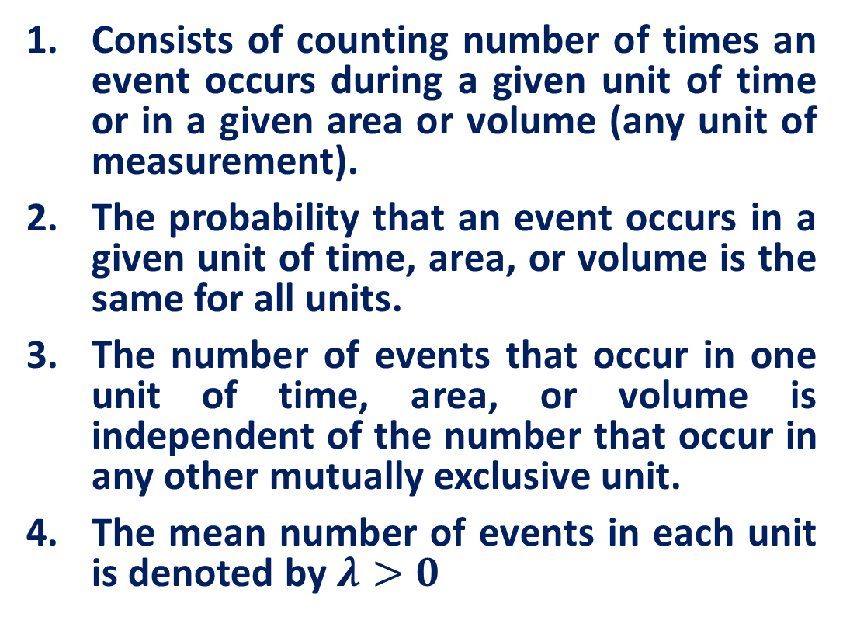
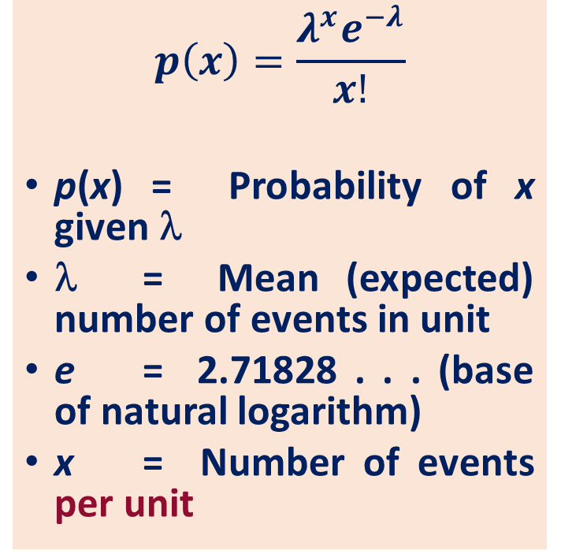
Recall: Poisson Distribution

Slide 38
Practice Example
As voters exit the polls, you ask a representative random sample of 6 voters if they voted for xyz. If the true percentage of voters who vote for xyz is 55.1%, what is the probability that, in your sample, exactly 2 voted for xyz and 4 did not?

Slide 39
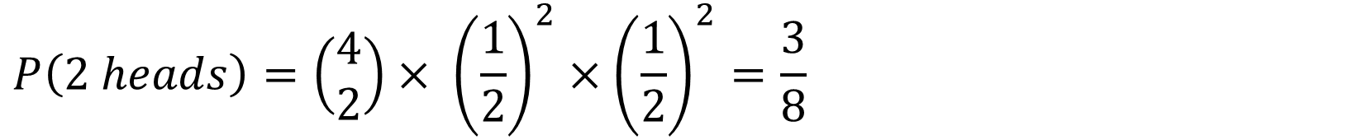
Practice Example
Four fair coins are flipped. If the outcomes are assumed independent, what is the probability that two heads and two tails are obtained?

Slide 40
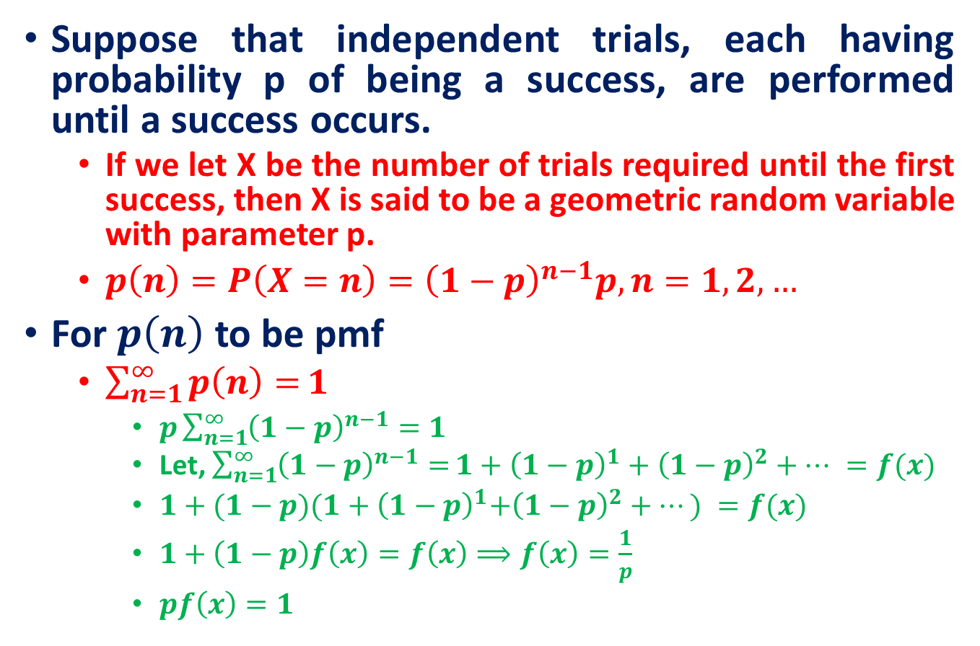
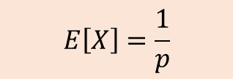
Geometric Distribution

Slide 41
Negative Binomial
Binomial:
Fixed number of n trials.
Each trial is independent.
Only two outcomes are possible (Success and Failure).
Probability of success (p) for each trial is constant.
A random variable Y= the number of successes.
Negative Binomial
The number of trials, n is not fixed.
Each trial is independent.
Only two outcomes are possible (Success and Failure).
Probability of success (p) for each trial is constant.
A random variable Y= the number of trials needed to make r successes.

Slide 42
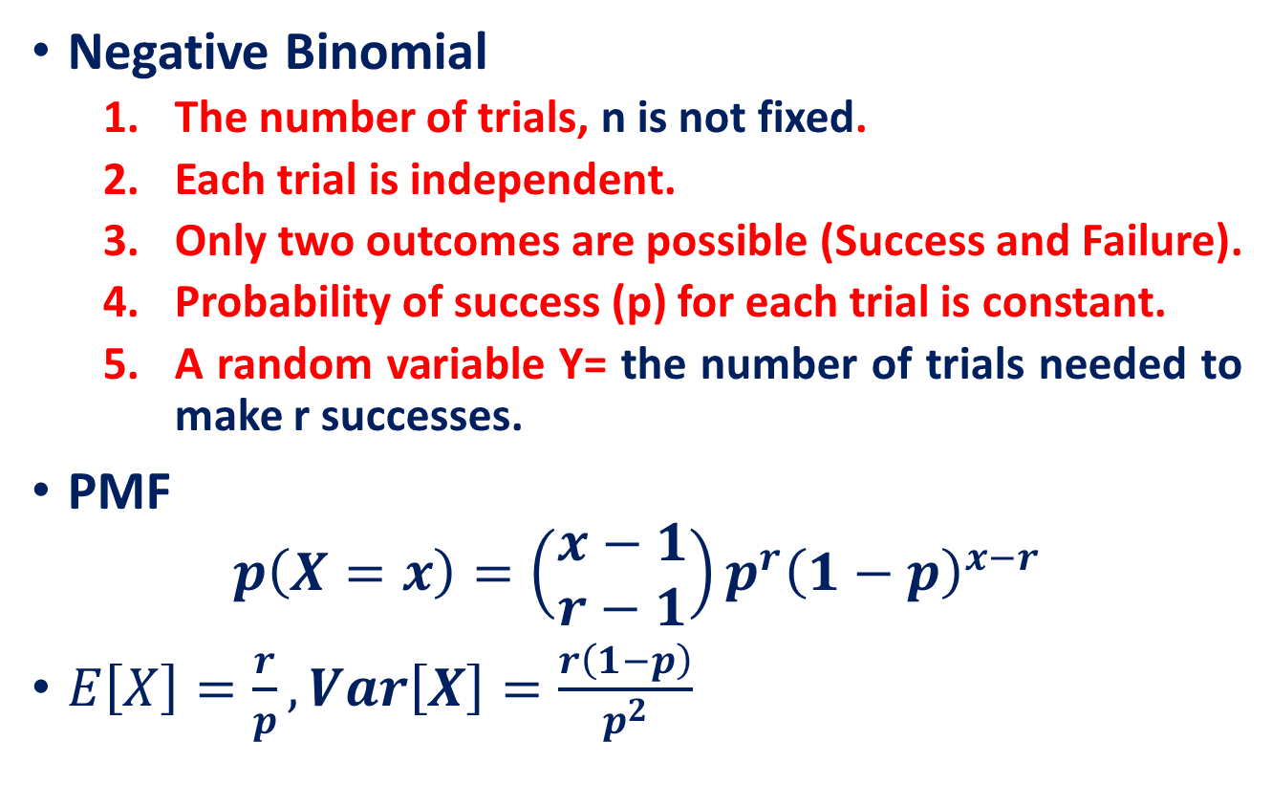
Negative Binomial

Slide 43
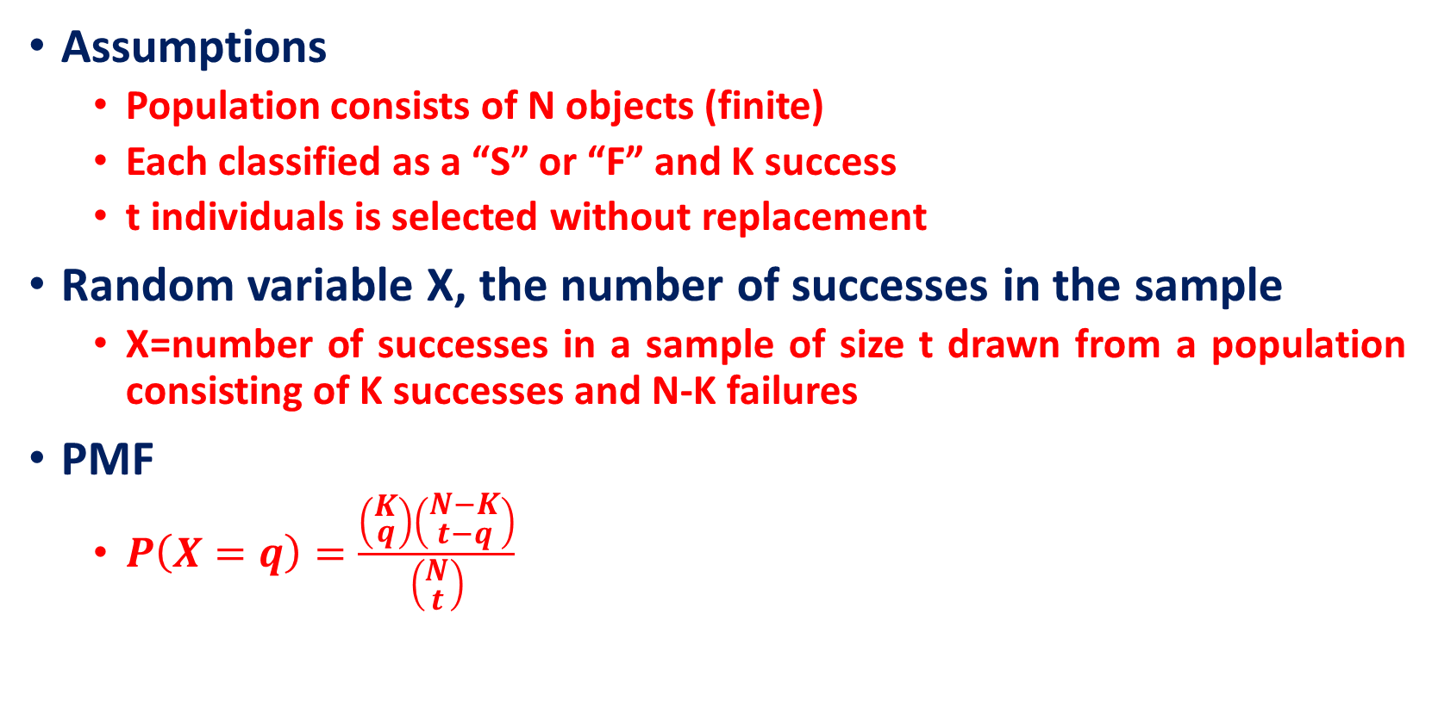
Hypergeometric Distribution

Slide 44
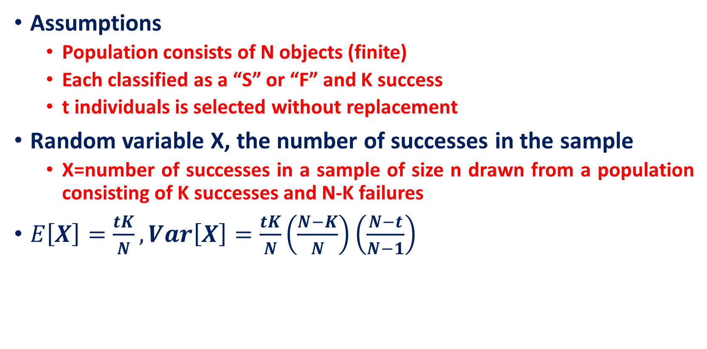
Hypergeometric Distribution

Slide 45
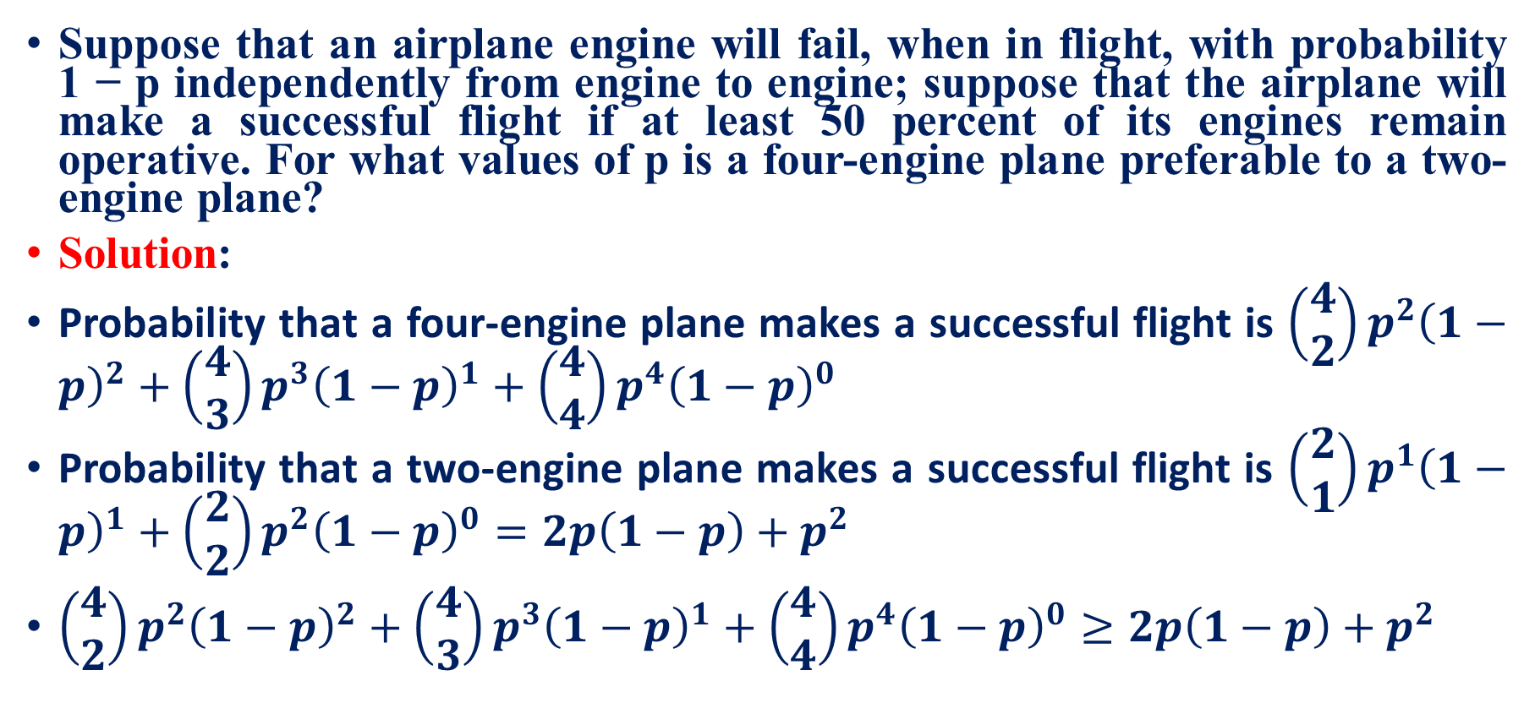
Practice Example

Slide 46
Reference
Lecture notes on Probability Theory by Phanuel Mariano
Schaum's Outline of Probability and Statistics, 4th Edition

